Slide 1
Analysing the Performance and Stability of LED-to-Camera Links
Shashwat Verma
Supervisor: Marco Zuniga

Slide 2
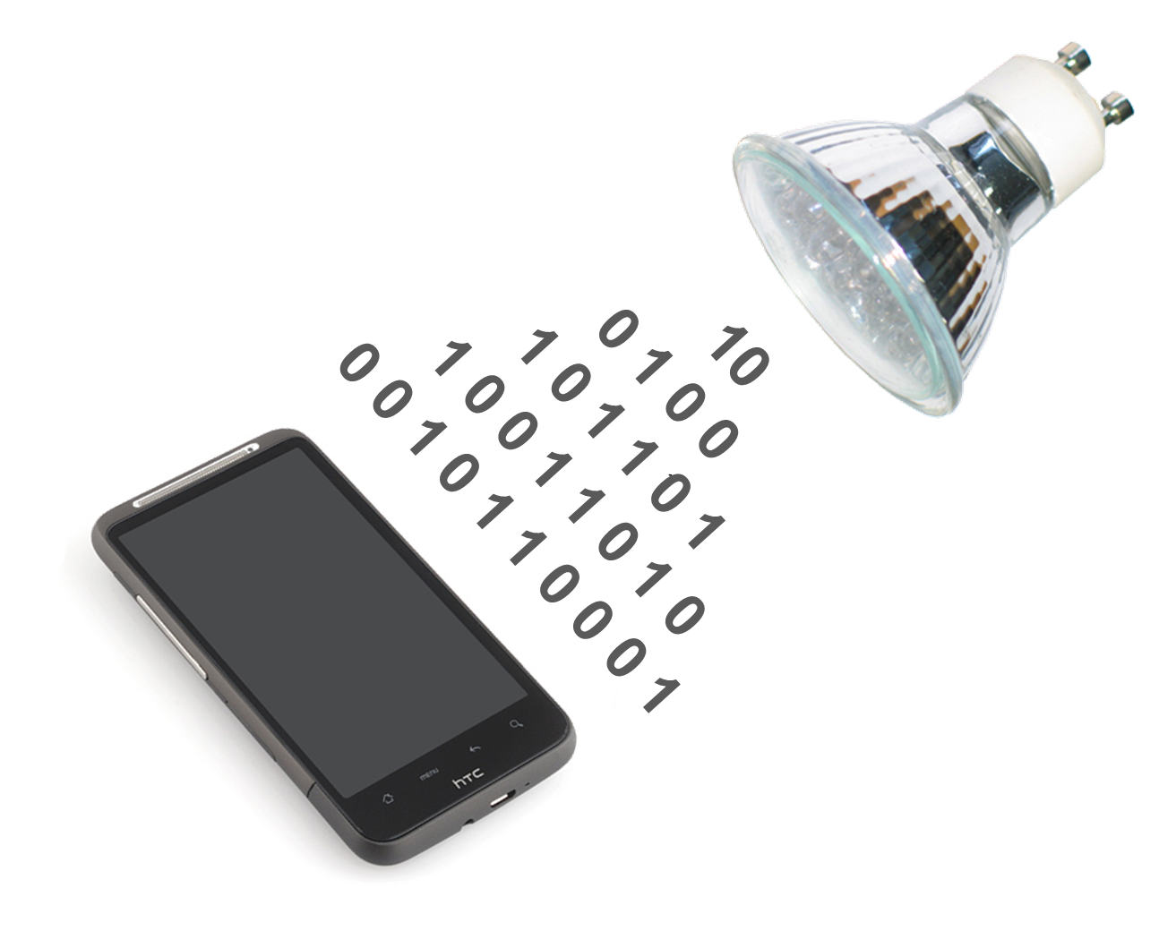
About VLC
Notes:
What is VLC, and how it is done.

Slide 3
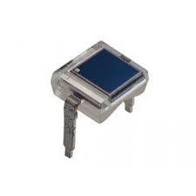

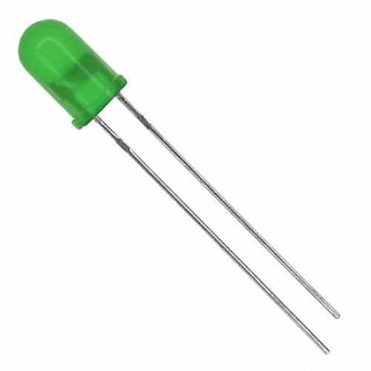
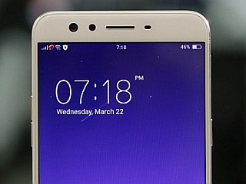
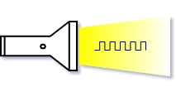
Transmitter - Receiver of VLC
Camera
Light sensor
LED
Smart-phone

Slide 4
Transmitter - Receiver of VLC
Photo Diode
Screen
LED
Camera
Light sensor
LED
Smart-phone

Slide 5
Smartphone’s Light Sensor
It is basically a photo-diode
Provides values in Lux
Light sensor
Notes:
Phone's light sensor
- it consists of photo-diodes
- give sample values in lux

Slide 6
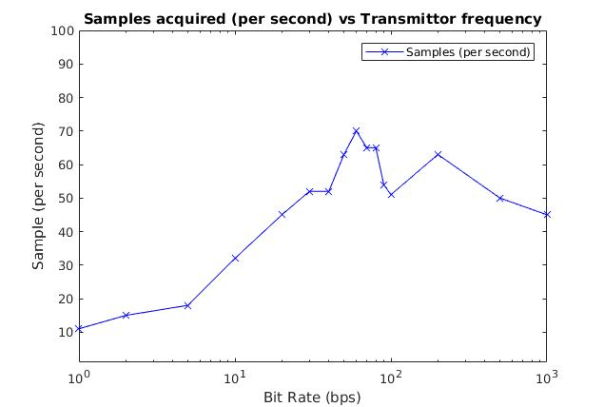
Smartphone’s Light Sensor
Disadvantages
Very slow sampling rate 100-120Hz
Controlled by OS, no control over values
Coarse granularity of values
Notes:
It doesn't work because of low sampling rate

Slide 7
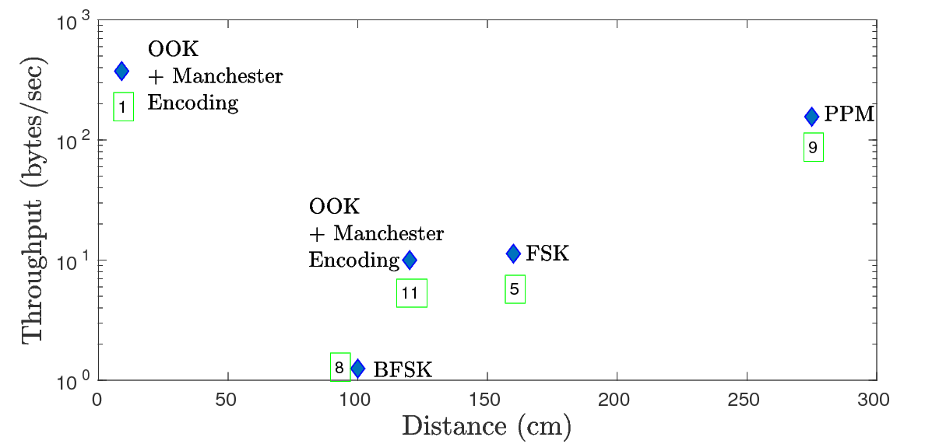
State-of-the-art Light-to-camera Link
1. CMOS for VLC 8. Visble light landmarks 11. DynaLight 5. RollingLight 9. Smartphone as continuous receiver
Notes:
It is a recent research topic.
Two variables smartphone or data encoding

Slide 8
Problem Statement
Which parameter in between smartphone camera and the data encoding method majorly affects the throughput of a light-to-camera communication link?
How to overcome the suboptimal throughout for longer distances of a light-to-camera communication link?

Slide 9
Outline
Implementation
Model
Evaluation

Slide 10
Implementation: Transmitter
Encoding Methods
- OOK
- PWM
- Manchester
- FSK

Slide 11
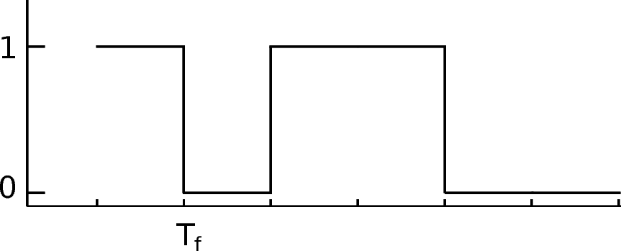
OOK Encoding
1:1 Encoding
Preamble is N+2 for N data bits

Slide 12
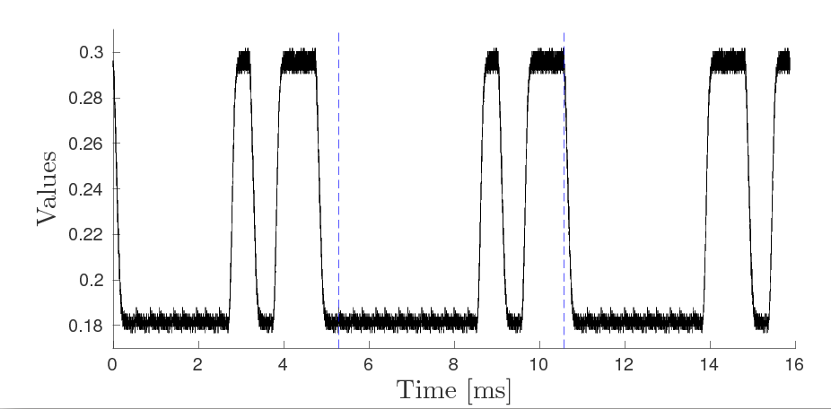
OOK Encoding

Slide 13
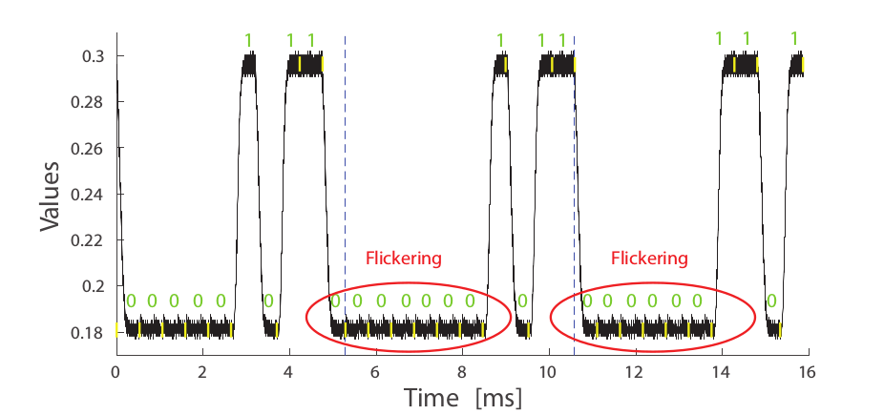
OOK Encoding

Slide 14
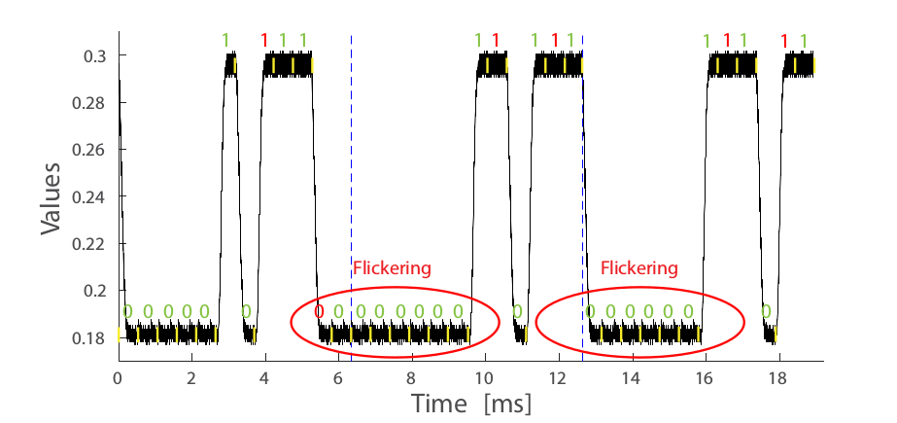
OOK Encoding

Slide 15
OOK Encoding
N/2 compensation symbols
Packet size will be 5/2 N + 3 for N data bits

Slide 16
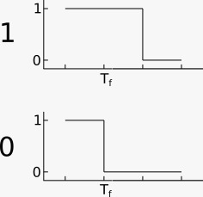
PWM Encoding
1:3 encoding

Slide 17
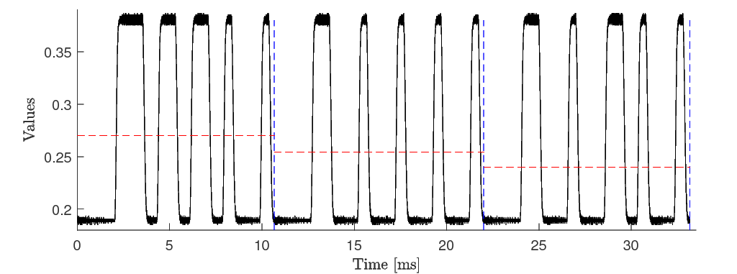
PWM Encoding

Slide 18
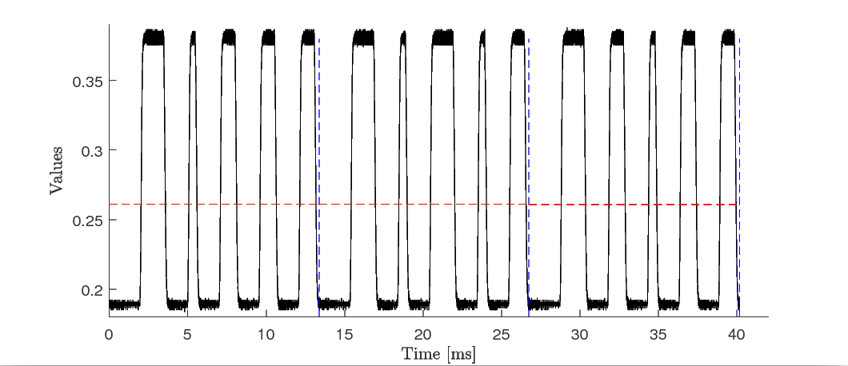
PWM Encoding

Slide 19
PWM Encoding
Preamble is 5 bits i.e., 10001
Compensation symbols N+1
Packet size 4N+9

Slide 20
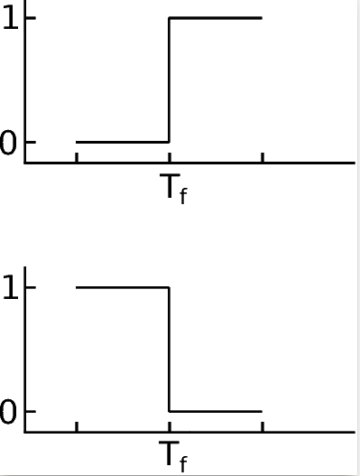
Manchester Encoding
1:2 Encoding

Slide 21
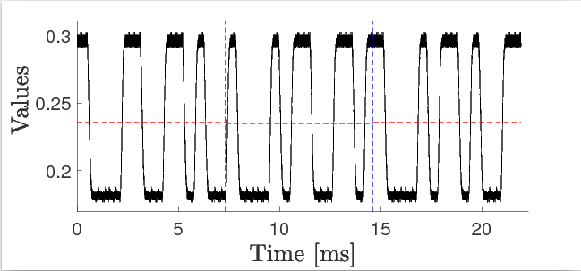
Manchester Encoding

Slide 22
Comparison of Encoding Schemes
Encoding Scheme | Symbol to bit ratio | Preamble Size | Compensation for flickering | Packet Size | Overhead (for N=8)
OOK | 1 | N+2 | N/2 | 5/2 . N+3 | 76%
PWM | 3 | 5 | N+1 | 4. N+9 | 81%
Manchester | 2 | 5 | - | 2. N+9 | 65%

Slide 23
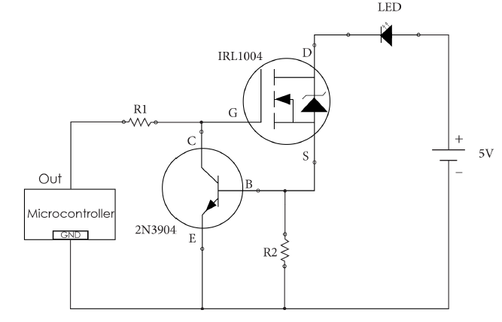
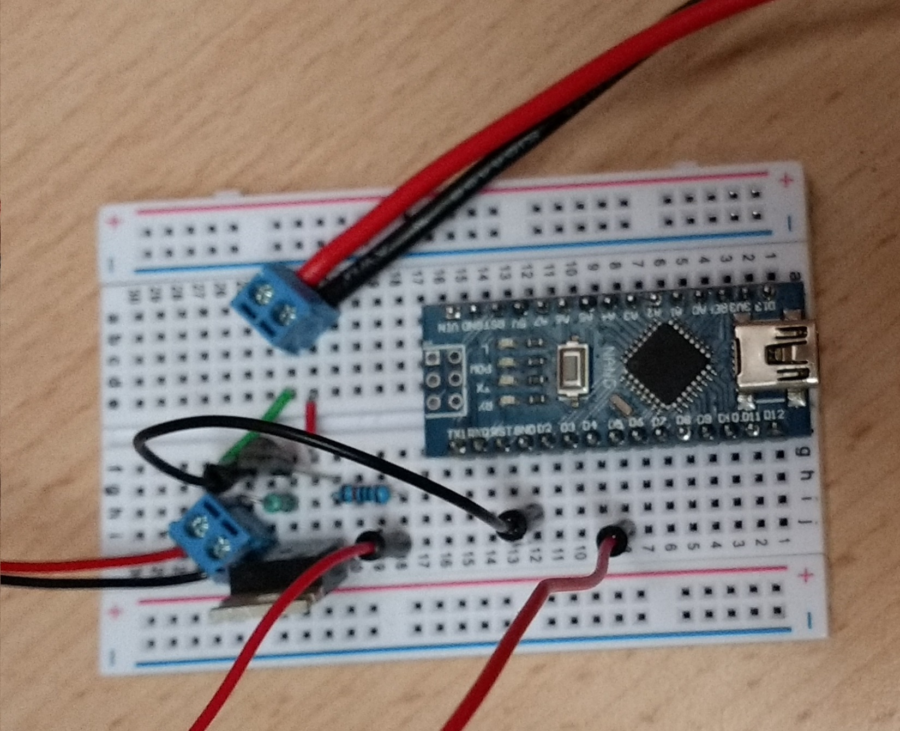
Implementation
System consists of 3 parts
Microcontroller (Arduino – atmega328p)
IKEA LED (XLamp MC-E White)
Smart-Phone(s)

Slide 24
Duty Cycle Adjustment

Slide 25
Receiver: Smartphone’s Camera
Provides fine granularity in values
Captures image using Rolling shutter effect
Camera

Slide 26
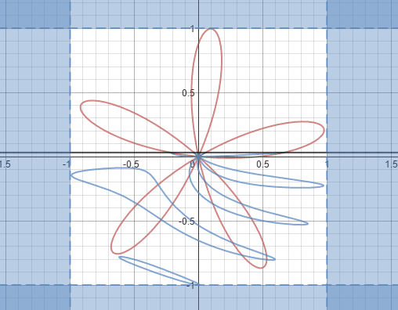
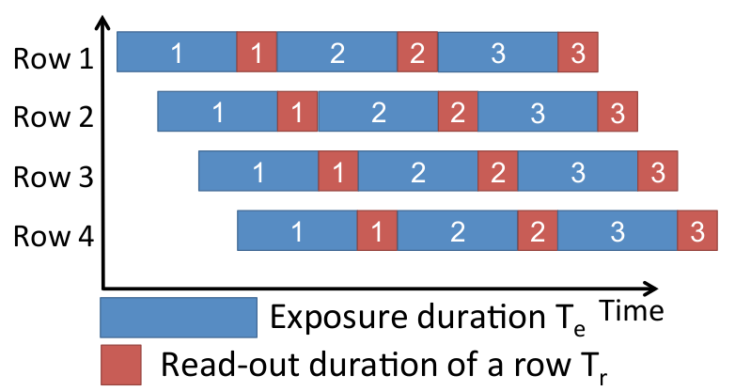
Rolling shutter Effect
Scans image row by row.
Provides faster sampling rate (5-10KHz)
Notes:
Explain TR and TE

Slide 27
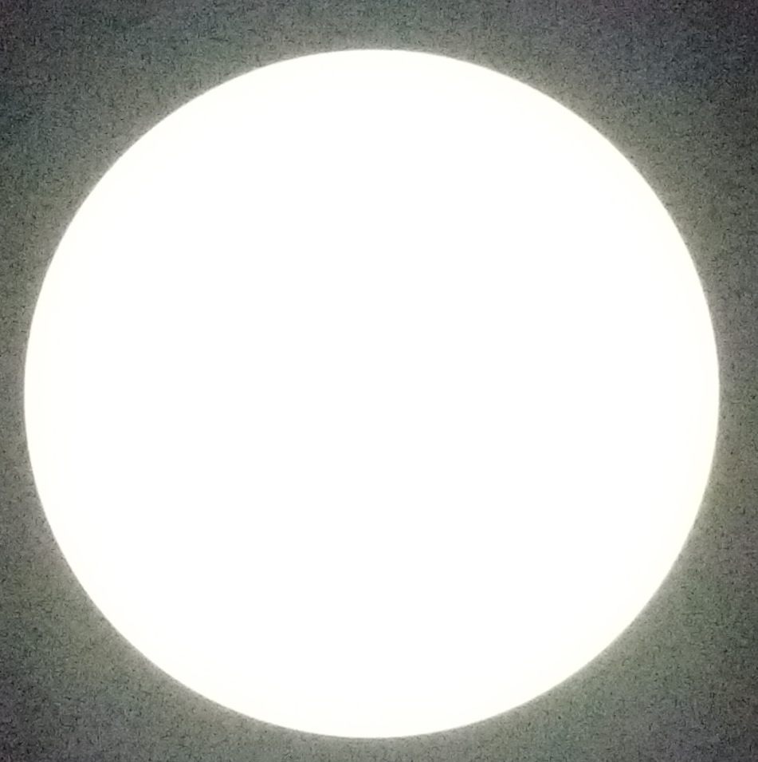
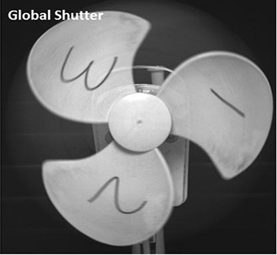
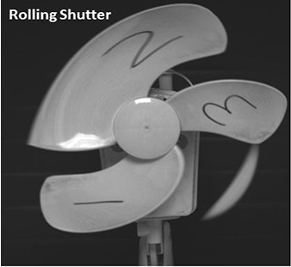

Rolling shutter Effect

Slide 28
Camera Parameters
Exposure Time
Frame Rate

Slide 29
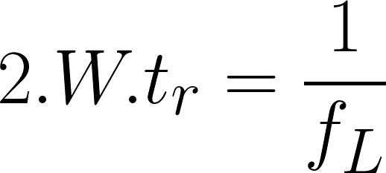


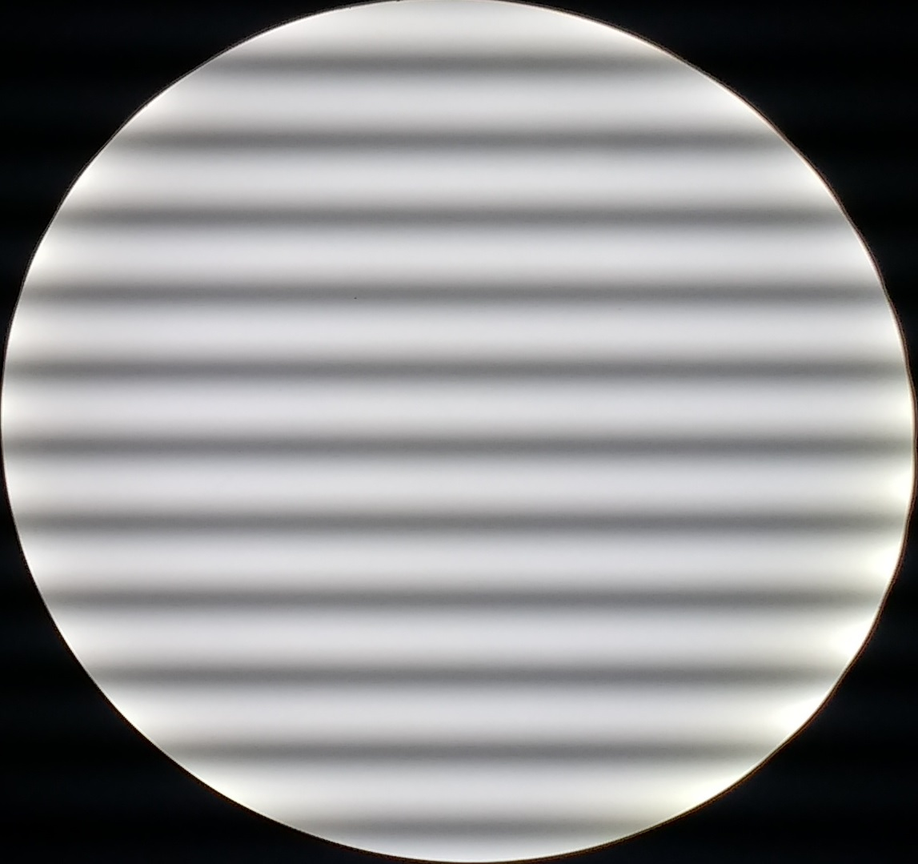
Exposure Time
Time taken by each pixel in a row to collect light
W= Symbol Width , f = Modulation Frequency T = Read-out Time
Exposure Time 161.62 us
Exposure Time 380.80 us
Exposure Time 495.54 us
Exposure Time 668.10 us

Slide 30
Related Works
Transmitter
Environment
Receiver
Notes:
Communication channel have 3 parts: tx, env, rx.
Comm channel depends on them.

Slide 31
Related Works
Transmitter
Environment
Receiver
Paper | Modulation | Range | Camera | Data Rate
Visual Light Landmarks | BFSK | 1m | 30fps | 1.25 bytes/sec
RollingLight | FSK | 1.5m | 30fps | 11.32 bytes/sec
Smartphones as Contineous Receivers | PPM | upto 2m | 240fps | 156.25 bytes/sec

Slide 32
Problem Statement
Create a framework which provide common ground for comparing different smartphones for data-link realiability and throughput.

Slide 33
Problem Statement
Create a framework which provide common ground for comparing different smartphones for data-link realiability and throughput.
Problem statement is broken to 4 phases
Camera as receiver
Mathematical framework
System Model
Implementation and Evaluation

Slide 34
Phase 1: Evaluation of Camera as receiver

Slide 35
Comparing Photo-diode with Camera
Fundamental differences between PhotoDiodes and Camera
Lower SNR
Information loss

Slide 36
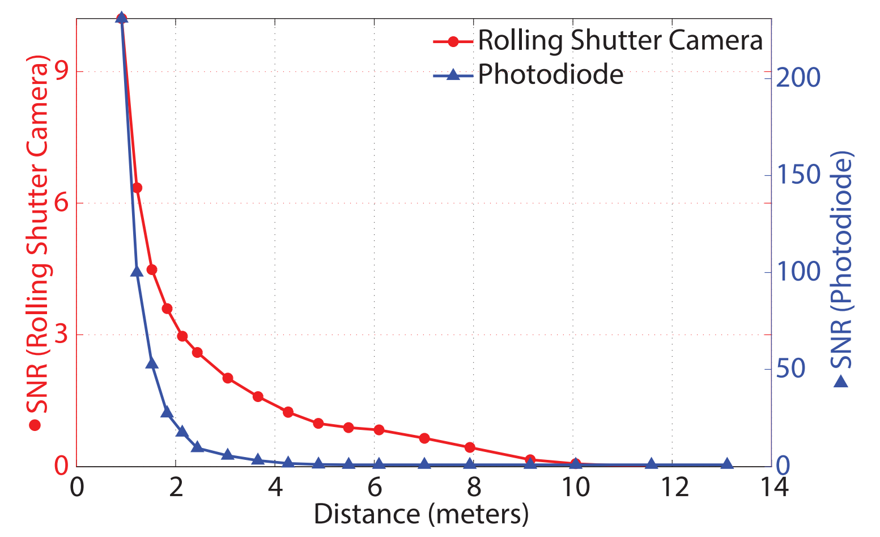
Difference 1: Lower SNR
Camera have very low SNR compaired to PD

Slide 37
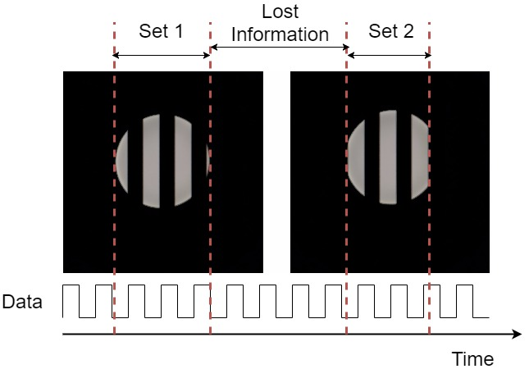
Difference 2: Information loss
Discretized samples in each frame

Slide 38
Phase 2: Mathematical Framework for Camera

Slide 39
Mathematical Framework
Model consists of 2 parameters
Exposure time
Effect of distance

Slide 40
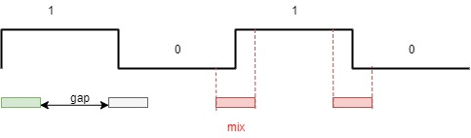
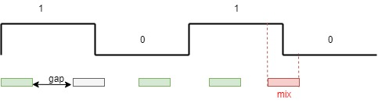
Parameter 1: Exposure Time
Different sampling rate (exposure time) causes mixed symbol effect
time
time
Frame duration > Symbol duration
Frame duration < Symbol duration
Notes:
Don’t explain in very complex way. Keep it simple.

Slide 41
Parameter 1: Exposure Time
Using this we can make upper and lower bounds on Exposure time (te).
f(t_{e}^{min}, t_{r}) => f_{s}

Slide 42
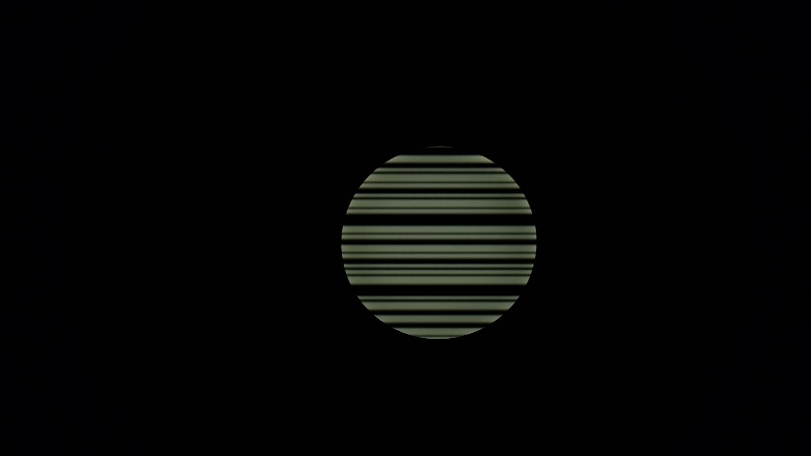


Parameter 2: Effect of distance
As distance from light increases image becames smaller. So, less area for sampling
50 cm
100 cm
200 cm

Slide 43
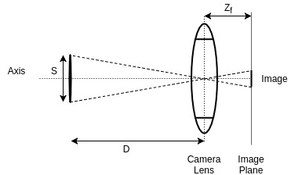
Parameter 2: Effect of distance
f(d, s, Z_{f}) => N

Slide 44
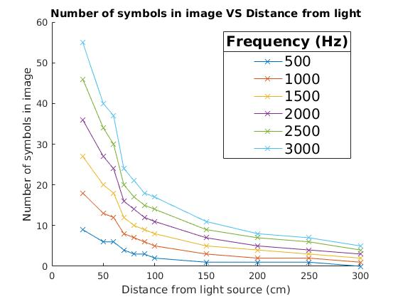
Parameter 2: Effect of distance
N = S’. f_{tx} . T_{r}
Notes:
Model ends here. Connect the dots

Slide 45
Phase 3: System Model

Slide 46
System Model
Different Modulation Schemes
Testbed for evaluation

Slide 47
Part 1: Different Data Modulation Schemes
Evaluation parameters
No flickering of light
Low Overhead (Goodput)
Longer Range
Lower Energy consumption

Slide 48
Data Modulation Schemes
OOK
PWM
Manchester
FSK
Preamble/
Header
Data
Parity
Compensation

Slide 49

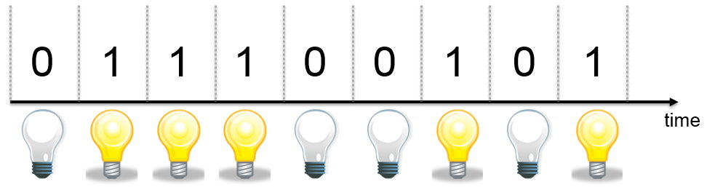
1. OOK modulation
Data
Bit stream

Slide 50
1. OOK modulation
Data
Bit stream
Header
Data
Tail
Compensation

Slide 51
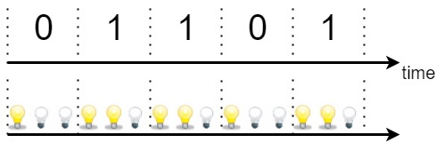
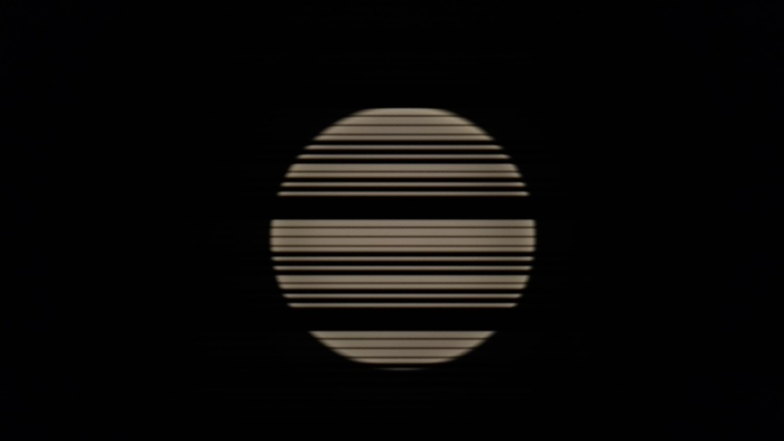
2. PWM modulation
Data
Bit stream

Slide 52
2. PWM modulation
Data
Bit stream
Header
Data
Tail
Compensation

Slide 53
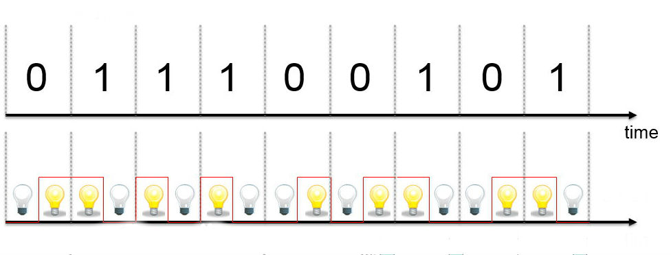

3. Manchester modulation
Data
Bit stream

Slide 54
3. Manchester modulation
Data
Bit stream
Header
Data
Tail
Compensation

Slide 55
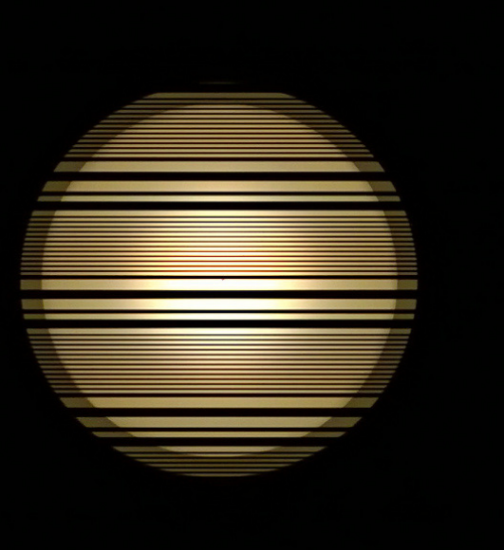
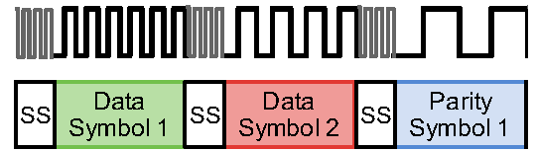
4. FSK modulation
Header
Data
Tail
Compensation

Slide 56
Part 2: Test setup for Evaluation
Test setup is divided in 3 subcategories
Adopting to asymmetric patterns in light
Improve previous platform for cross mobile usage
Platform for decoding incoming data

Slide 57
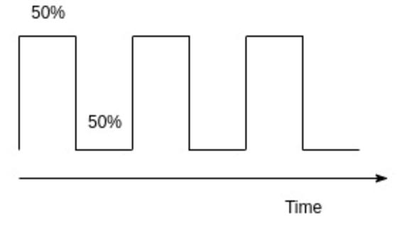
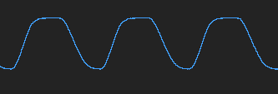
1: Adopting to asymmetric patterns in light

Slide 58
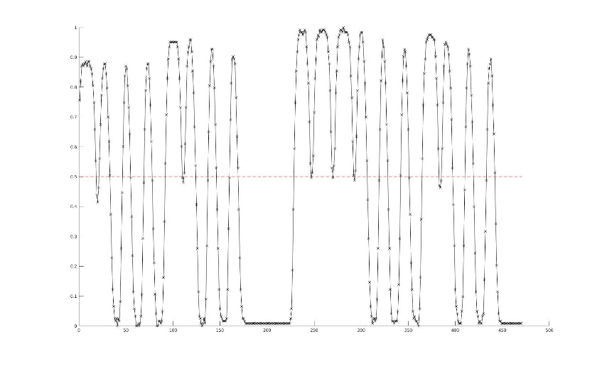

1: Adopting to asymmetric patterns in light

Slide 59
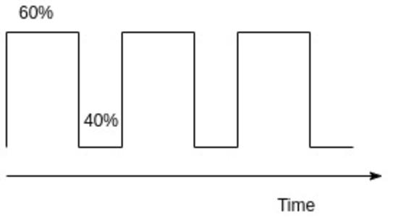
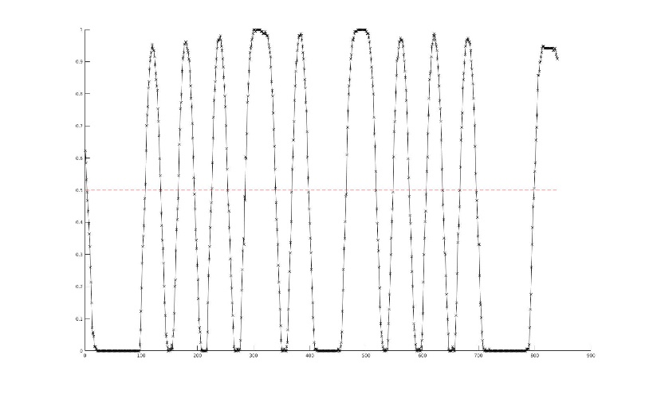

Solution:
1: Adopting to asymmetric patterns in light

Slide 60
2: Improve previous platform for cross mobile usage
Image overlap while processing
False light detection
Image Proceesing pipeline crashes sometimes

Slide 61
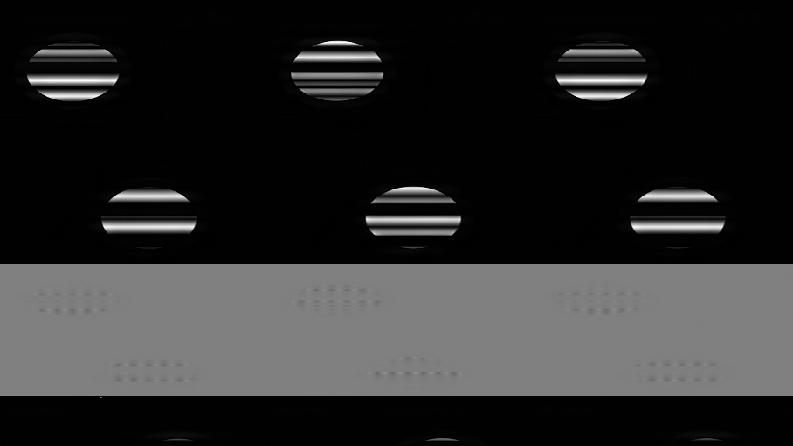

2: Improve previous platform for cross mobile usage
Image overlap while processing
False light detection
Image Proceesing pipeline crashes sometimes

Slide 62
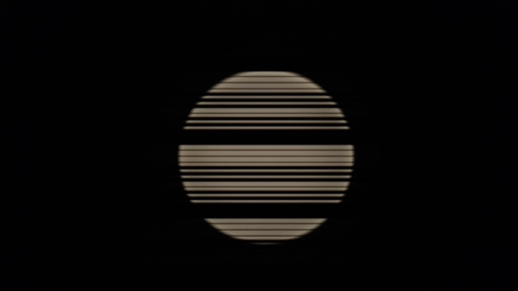
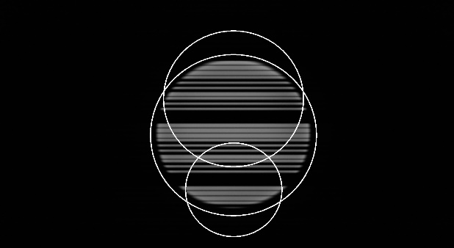
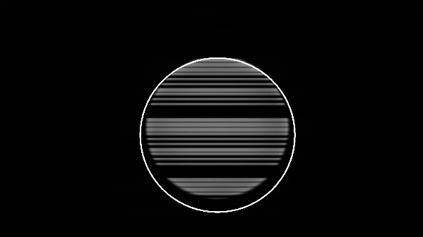
2: Improve previous platform for cross mobile usage
Image overlap while processing
False light detection
Image Proceesing pipeline crashes sometimes

Slide 63
2: Improve previous platform for cross mobile usage
Image overlap while processing
False light detection
Image Proceesing pipeline crashes sometimes

Slide 64
3: Platform for decoding incoming data
Methods for different Encoding schemes
Modulation Scheme | Methods | Complexity
OOK | Not feasible | High
PWM | Thresholding | Low
Manchester | Machine learning based thresholding | Medium
FSK | Time based thresholding | Low

Slide 65
Phase 4: Implementation and Evaluation

Slide 66
Evaluation
For each encoding scheme Packet-Received-Ratio at different frequencies is calculated

Slide 67
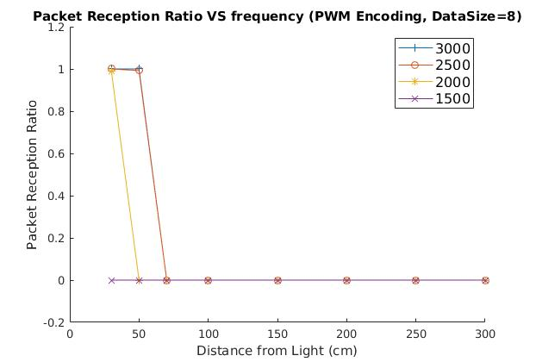
PWM Encoding

Slide 68
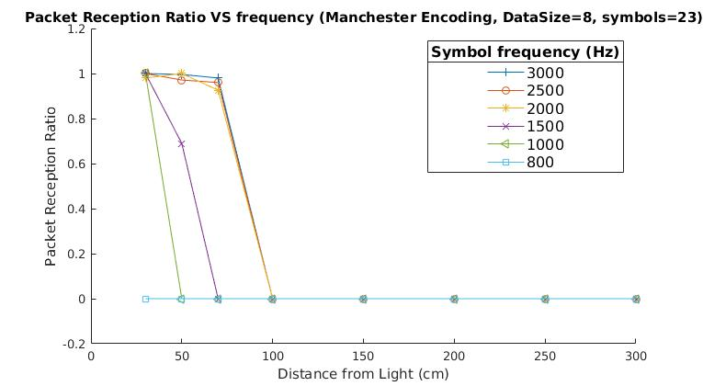
Manchester Encoding

Slide 69
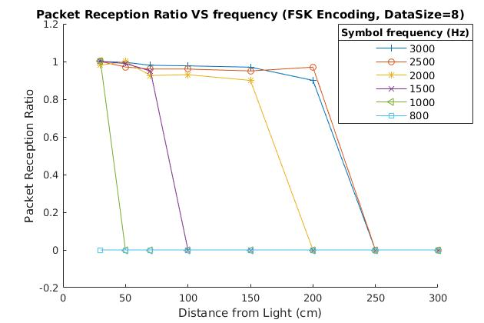
FSK Encoding

Slide 70
Modulation Schemes Comparision
Scheme | Compensation | Overhead | Range | Decoding Complexity
OOK | 6 | 68% | ~ 60cm | High
PWM | 4 | 72% | ~ 50cm | Low
Manchester | - | 65% | ~ 1m | Medium
FSK | - | 60% | ~ 2m | Low

Slide 71
Remaining Work
Mathematical Model - On going work
System Model - Completed
Evaluation of Model - On going
different lights,
different phones (cameras),
different exposure times

Slide 72
Thank you!

